Slide 1
Office of Budget and Finance CUNYfirst

Slide 2
Procurement and A/P Module
Going LIVE on June 27 for ALL State funded activity
All transactions processed through the State and City’s systems will be processed through CUNY first
Tax levy - all
IFR - senior
ACE, LIP, Technology Fee, Non-Misc - community
Interfaces to City and State’s systems will go from/to CUNYfirst
Training for A/P and procurement staff and end users (i.e., requesters and approvers) have commenced and are ongoing
Notes:
Please mention that:
Expect a smooth transition to CUNYfirst – as we have already implemented CUNYfirst procurement and accounts payable module for community colleges. The system has also been
CUNYfirst with additional system functionality such as the travel and expense card module, p-cards, contract supplier management and strategic sourcing – all of which will increase overall processing efficiencies.

Slide 3
Procurement and A/P Module
Highlights of system:
Validation of budget availability at every step of procurement process
Segregation of duties will be enforced through role assignments
All orders require a requisition and a purchase order
System receipts are required to complete all vouchers
The system will perform a matching process
Future functionality:
Travel and expense card module
P-cards
Contract supplier management and strategic sourcing
Notes:
Please mention that:
Expect a smooth transition to CUNYfirst – as we have already implemented CUNYfirst procurement and accounts payable module for community colleges.

Slide 4
Why CUNYfirst works for CUNY?
Out with the OLD and In with the NEW
Elimination of our outdated Legacy Systems
NO MORE GREEN SCREENS!!!!
Use of On-Line and Self Service Tools
An Integrated System Supports the Integrated University
Lots of data is available in one system
Subledger ties to the general ledger
Less data input and more data analysis
No need to extract data from SIMS and input into CUNYfirst
Standardization of data, processes and procedures
One Chart of Accounts
Ability to stop students from registering at one college if they owe money at another campus

Slide 5
Why CUNYfirst works for CUNY?
Information can be retrieved with more ease and offers greater flexibility in reporting
Support Accountability
Automated approvals through workflow
Simplification of legacy processes
Students are better served for direct deposit election through self-service
No more collection of paper direct deposit slips and inputting in system
Colleges will no longer produce manual tuition & fee refund checks
A/P and Procurement staff can systematically copy from requisition
Automated Alerts

Slide 6
Moving Forward
Complete Core Implementation
Broaden Scope and Implement Enhancements
Enhance functionality based on University priorities
Standardize Workflows
CUNYfirst has provided the framework, now we need to leverage it
Implement an Integrated Content Management System
Enhance Reporting
Strengthen Roles and Internal Controls
Enhance Support and Training to Colleges
Develop Job Aids and Document Policies, Procedures and Workflows

Slide 7
Moving Forward
The Future of the Finance and Administrative Area:
Economic, efficient and effective processes, workflows and procedures
Results measured through:
Performance Metrics
Benchmarking and Setting Targets
Performance Reporting
Strategically use our financial and human resources:
Robust Strategic Sourcing/Collaborative Purchasing program
Shared Services

Slide 8
2013 CUNY Finance Officers Forum June 25, 2013

Slide 9
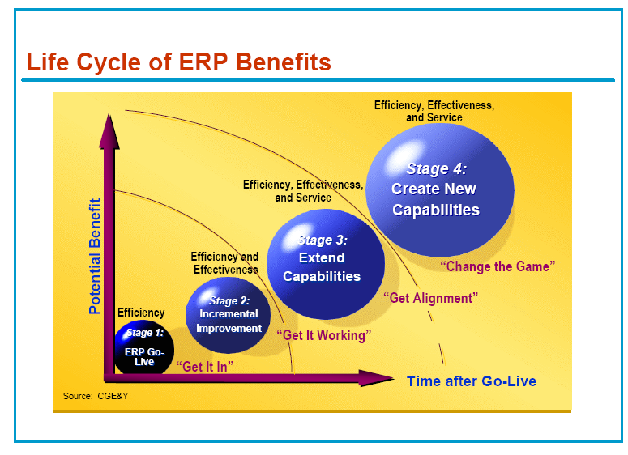
From Educause - ECAR

Slide 10

CUNYfirst Implementation Status
Implement Current Scope

Slide 11

CUNYfirst Implementation Status

Slide 12
CUNYfirst – Sunsetting Legacy Systems
Sunset Legacy Systems
CUPS – 2008
TIFF (BMCC) - 2013
SIMS/eSIMS – 2014
Banner (GC) – 2014 / 2015
FIS/FAS – 2015
EPS – 2015
Insight – 2014

Slide 13
CUNYfirst – Enhancements Already Implemented
Non-CUNY Originated Payment Interfaces from City/State
City University Construction Fund data from the City (2013)
Expanded budget planning targets
City College Targets – Using expenditure types to match the City types
Operating Unit added to Fund 11 targets (City/State)
MWBE Compliance Reports – using ESDC vendor certifications
TAM Security, FAQs and improved job applicant experience / job search functions
Search by Description added to all GL Chartfields
Work-study using Commitment Accounting
Sallie Mae
Checking of valid student account prior to issuing refunds
Mass Reappointment Manager Spreadsheet upload
TAM upload documents by Job Opening
TAM upload of multiple file types
Math Regents
Archibus data interface for all Campus Solutions pillars

Slide 14
CUNYfirst – Enhancements Already Implemented
Additional Campus Solutions fields to I-805 and ADW
Availability of Reporting instance
Outstanding CUNYfirst student financials balances report
Textbook component enhancement
Student Financials Ageing report
Enhancements related to pathways
Financial Aid view only data pages
SAP Attempted Credits in lieu of Earned Credits
Repeat policy modifications (Undergraduate F Grade forgiveness)
CAS/ASTA change to load SCD1 student group as potential SEEK/CD students
Faculty Center Grade Roster date closing
Import grade roster
Provisioning enhancements to enable faculty access to CUNYfirst prior to appointment and after termination
Provisioning enhancements for students to check financial aid prior to matriculating

Slide 15
CUNYfirst – A Vision for the Next 5 Years
Functional/Process Enhancements
Integrate with ECM
Upgrade / Enhance to latest Peoplesoft Versions and Current Technologies
Better Look and Feel
Mobility
Social Network Functionality and Integration
Ease of Use Enhancements
Reporting Enhancements / Business Intelligence
Standardization
Implement / refine models for Support and Training
Standard practices for training
Job Aids
Documented, Accepted and Communicated Policies, Procedures and Workflows
Disaster Recovery and Business Continuity

Slide 16
CUNYfirst – Problem Resolution and Enhancements
Problem Resolution – must log CRM Tickets
Level 1 – Campus Help Desk
Level 2 – Central Help Desk / Production Support Team
Level 3 – Subject Matter Experts (Implementation, Production Support Security, IMS Teams), Oracle Consulting, Oracle Development (GSC), Oracle Hosting or Business Process Owner
Requesting Enhancements – C5 Form Signed by the Campus Executive, Business Manager or Vice Chancellor
Effort estimated by CIS
C5 Enhancements prioritized by the Business Process Owner
Implemented after approval by the governance board

